Slide 1
VOICE
Diction
Detail
Imagery
Syntax
Tone

Slide 2
VOICE
Effective voice is shaped by words that are clear, concrete, and exact. Good writers eschew (to avoid; to shun) words like “pretty, nice, good, beautiful, fine, things, really, very, terrible, a lot, and bad.” Instead they employ words that invoke a specific effect.

Slide 3
VOICE IS THE FINGERPRINT OF A PERSON’S LANGUAGE
There are 5 elements of voice:
Diction
Detail
Imagery
Syntax
Tone

Slide 4
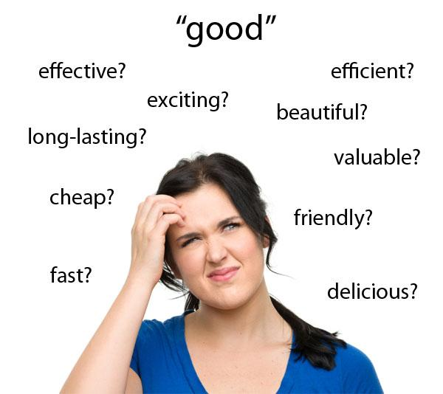
DICTION
Diction refers to word choice. It is the
foundation of voice and contributes to all of
its elements.
Words:
Create color and texture
Reflect and determine the level of formality
Shape the reader’s perceptions
When reading serious literature, NEVER skip words you do not know! It is tantamount to wearing earplugs when you attend a symphony.

Slide 5
DICTION
Effective voice is shaped by words that are clear, concrete, and exact. Good writers will tell you that the door does not shut, it thuds. He is not wearing a torn coat, it is a tattered coat.
Diction depends on:
Topic-There is a vast difference in word choice from an article on computers and a short story by Poe.
Purpose-Words are chosen to impart a particular effect: convince, entertain, amuse, inform or plead.
Occasion-This is the level of formality; formal (scholarly writing), informal (the norm and includes slang and colloquial diction)

Slide 6
DICTION
Other terms that accompany the study of diction are connotation and denotation.
Denotation-dictionary definition of a word.
The red curtains are hanging. (red allows you to see the color of the curtains)
Connotation-the meaning suggested by the word.
The blood red curtains are hanging. (using blood in front of red creates a completely different feeling.
Good writers make choices to balance complexity and simplicity.
Good writers make choices to balance multiple meanings with precision.

Slide 7
DICTION
“Twenty bodies were thrown out of our wagon. Then the train resumed its journey, leaving behind it a few hundred naked dead, deprived of burial, in the deep snow of a field in Poland.”
-Elie Wiesel, Night
How would the meaning change if we substituted dead people for bodies?
Fifteen chickens were slaughtered for the feast.
Change the word above to a word that disassociates the reader from the true action of the sentence.

Slide 8
“In fact, a hyena’s catholicity of taste is so indiscriminate it nearly forces admiration. A hyena will drink from water even as it is urinating in it. The animal has another original use for its urine: in hot, dry weather it will cool itself by relieving its bladder on the ground and stirring up a refreshing mud bath with its paws. Hyenas snack on the excrement of herbivores with clucks of pleasure. It’s an open question as to what hyenas won’t eat. They eat their own kind (the rest of those whose ears and noses they gobbled down as appetizers) once they’re dead, after a period of aversion that lasts about one day. They will even attack motor vehicles--the headlights, the exhaust pipe, the side mirrors. It is not their gastric juices that limit hyenas, but the power of their jaws, which is formidable.” Life of Pi p. 117

Slide 9
USING YOUR UNDERSTANDING OF LIFE OF PI, COMPLETE THE FOLLOWING:
1. Discuss the bold words and their effect on the paragraph.
2. Replace the bold words for a different effect.

Slide 10
DETAIL
Detail includes facts, observations, and
incidents used to develop a subject and
impart voice.
Details a writer includes or excludes help shape voice.
In elementary and middle school, you were asked to include as much detail as possible. As a high school student, you will be asked to choose your details carefully for analysis that do not detract or trivialize your purpose.

Slide 11
DETAIL
Specific details refer to fewer things than general descriptions, thereby creating a precise mental picture. However, the more specific the details are, the greater the focus on the object described.
Detail brings life and color to description, focusing your attention and bringing you into a specific scene.
Detail encourages you to participate in the text, use of detail influences your view on the topic, setting, narrator, and author.
Detail can be an understatement by a LACK of detail. The absence of specific details, for example, may be in sharp contrast to the intensity of a character’s pain. In this case, elaborate, descriptive detail could turn the pain into sentimentality.

Slide 12
DETAIL
An old man, Don Tomasito, the baker, played the tuba. When he blew into the huge mouthpiece, his face would turn purple and his thousand wrinkles would disappear as his skin filled out.
-Alberto Alvaro Rios, “The Iguana Killer”
Compare the first two sentences.
Contrast the second sentence with the following. How does it change the attitude toward Tomasito?
When he blew the tuba, his face turned purple and his cheeks puffed out.

Slide 13
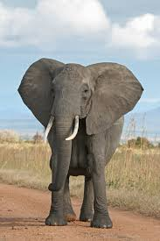
DETAIL: GEORGE ORWELL,
“SHOOTING THE ELEPHANT”
I rounded the hut and saw a man's dead body sprawling in the mud. He was an Indian, a black Dravidian coolie, almost naked, and he could not have been dead many minutes. The people said that the elephant had come suddenly upon him round the corner of the hut, caught him with its trunk, put its foot on his back and ground him into the earth. This was the rainy season and the ground was soft, and his face had scored a trench a foot deep and a couple of yards long. He was lying on his belly with arms crucified and head sharply twisted to one side. His face was coated with mud, the eyes wide open, the teeth bared and grinning with an expression of unendurable agony. (Never tell me, by the way, that the dead look peaceful. Most of the corpses I have seen looked devilish.)

Slide 14
DETAIL: GEORGE ORWELL,
“SHOOTING THE ELEPHANT”
What is the author’s attitude toward the coolie’s death?
What details in the passage reveal this attitude?
Examine the last sentence of this paragraph. How would it have affected the overall impact had Orwell written, his eyes wide open, his teeth bared and grinning…?

Slide 15
Reread chapter 15 from Life of Pi (pages 45-46) and answer the following question:
Identify and describe what specific details reveal about the character of Pi, his perspective, and his motives.

Slide 16
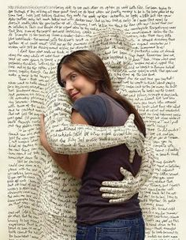
IMAGERY:
Imagery is the verbal representation of sensory
experience. The different types of imagery are:
Visual-sight Auditory-sound
Tactile-touch Gustatory-taste Olfactory-smell
Imagery depends on both diction and detail: the success in producing a sensory experience results from the specificity of the author’s diction and choice of detail.

Slide 17
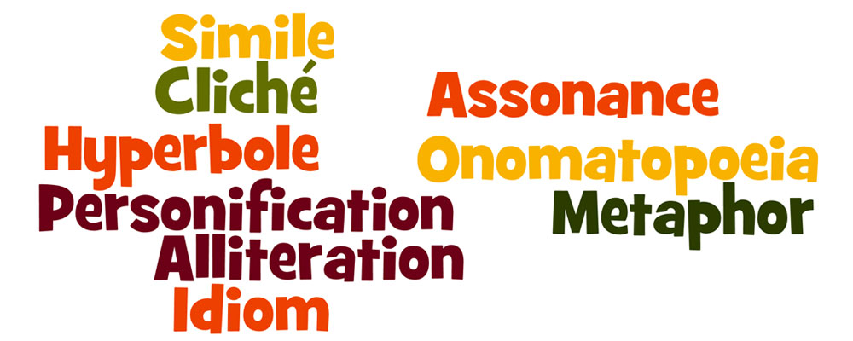
IMAGERY:
Imagery includes figurative language:
Visual Simile: compare using like or as
Metaphor: compare without like or as
Hyperbole: extreme exaggeration
Extended Metaphor: a metaphor introduced and then further developed throughout all or part of a literary work, especially a poem: Robert Frost uses two roads as an extended metaphor in “The Road Not Taken.”
Personification: giving human characteristics to an object
Allusion: reference to a mythological, literary, historical, or Biblical person place or thing.

Slide 18
IMAGERY:
In the midst of poverty and want, Felix carried with pleasure to his sister the first little white flower that peeped out from beneath the snowy ground.
-Mary Shelly, Frankenstein
What do you understand about Felix from the imagery of this sentence?
How would the effect be different if Felix carried his sister a big bouquet of spring flowers?
Write a sentence which expresses the joy of a renewal through a visual image.

Slide 19
IMAGERY:
“A foul and pungent smell, an earthy mix of
rust and excrement, hung in the air. There was
blood everywhere, coagulating to a deep read crust. A single fly buzzed about, sounding to me like an alarm bell of insanity. No ship, nothing at all, had appeared on the horizon that day, and now the day was ending. When the sun slipped below the horizon, it was not only the day that died and the poor zebra, but my family as well. With that second sunset, disbelief gave way to pain and grief. They were dead; I could no longer deny it.” p. 127 Life of Pi
Identify and explain the function of imagery in this passage.

Slide 20
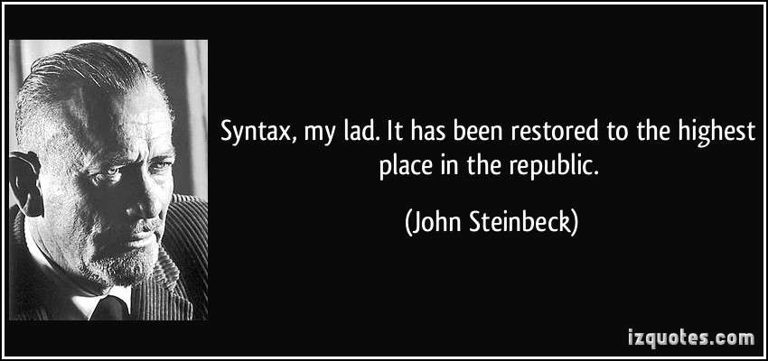
SYNTAX
Syntax is the grammatical sentence structure.
It controls the verbal pacing and the focus
of the written text through word order, sentence
length, sentence focus, and punctuation.
Most sentences follow subject/verb/object/complement pattern.
Deviating from that pattern can serve to startle your reader and draw attention to the sentence, emphasizing the unusual message in the sentence.
Sentence Length:
Telegraphic-shorter than 5 words
Short-approximately 5 words
Medium-approximately 18 words
Long/Involved-30 words or more

Slide 21
SYNTAX
Sentence Patterns:
Declarative, Imperative, Interrogative, Exclamatory
Simple, Compound, Complex, Compound Complex
(CC=2 or more independent clauses and one or more dependent clauses.
Cumulative/Loose-a main clause that is followed by phrases and/or clauses that modify the main clause and add information: “We reached Edmonton that morning after a turbulent flight and some exciting experiences.”
Periodic Sentence-makes sense only when the end of the sentence is reached:
“That morning, after a turbulent flight and some exciting experiences, we reached Edmonton.”
Balanced-phrases or clauses balance each other in likeness, structure, meaning and/or length.
“Buy a bucket of chicken and have a barrel of fun.”

Slide 22
SYNTAX
Sentence Patterns:
Natural Order-subject, predicate
Inverted-predicate, subject
Split order-predicate, subject, predicate “In California oranges grow.”
Parallel Structure- grammatical or structural similarity between sentences or parts of a sentence involving arrangement of words, phrases, sentences, and paragraphs so that elements of equal importance are equally developed and similarly phrased. A sentence, article, chapter, and even book can be written in parallel structure. Parallel denotes equality.
Juxtaposition-a poetic and rhetorical device which normally unassociated ideas, words, or phrases are placed next to one another, creating an effect of surprise. “It was the best of times, it was the worst of times…”

Slide 23
SYNTAX
“I slowed still more, my shadow pacing me,
dragging its head through the weeds that hid
the fence.”-William Faulkner,
The Sound and the Fury
In this sentence, form imitates meaning. How does Faulkner slow
the sentence down, reinforcing the sentence’s meaning?
How would this impact the sentence?
I slowed still more. My shadow paced me and dragged its head through the weed-obscured fence.
Write a sentence that expresses reluctance. Use at least two phrases and one subordinate clause to reinforce the meaning of your sentence.

Slide 24
SYNTAX
“Darkness came. There was no moon. Clouds hid the stars. The contours of things became hard to distinguish. Everything disappeared, the sea, the lifeboat, my own body. The sea was quiet and there was hardly any wind, so I couldn’t even ground myself in sound. I seemed to be floating in pure, abstract blackness. I kept my eyes fixed on where I thought the horizon was, while my ears were on guard for any sign of animals. I couldn’t imagine lasting the night.” p. 118 Life of Pi
What type of grammatical structures are present in this paragraph and
what is the effect of these structures?
2. What type of sentence is the fifth sentence, and what effect does it have on the text?
3. Identify and describe specific textual details that convey the setting.
4. Identify and describe details, diction, or syntax that reveals the narrator’s perspective.

Slide 25
TONE
Tone is the writer’s or speaker’s attitude towards
their subject, audience, or self; it is the emotional meaning
of a work.
When a person is speaking, it is easy to notice the tone of his or her voice. An author must rely on other techniques to show tone: diction, detail, images, and syntax. Diction, detail, imagery, and syntax create the author’s tone. Tone is the key to understanding the author’s intentions and feelings. TONE IS NOT MOOD.
It is important to describe the tone in as precise of diction as possible. The tone can never be happy but instead elated, pleased friendly…
An analysis of tone will depend on our precise and accurate understanding of the author’s attitude toward THE SUBJECT and THE AUDIENCE.

Slide 26
TONE
DIDLS
D-diction (word choice)
I-imagery (vivid appeal to the senses)
D-detail (concrete and literal facts)
L-language (the overall use of language in the entire piece, not just isolated diction as with connotation. These words qualify how a work is written, not tone, or attitude. Some examples are: jargon, scholarly, informal, precise, literal, colloquial, formal, picturesque, obscure…)
S-Syntax (sentence structure)

Slide 27
TONE
“And I start to play. It was so beautiful. I was so caught
up in how lovely I looked that at first I didn’t worry how I
would sound. So it was a surprise to me when I hit the
first wrong note and I realized something didn’t sound quite right. And then I hit another and another followed that. A chill started at the top of my head and began to trickle down. Yet I couldn’t stop playing, as though my hands were bewitched. I kept thinking my fingers would adjust themselves back, like a train switching to the right track. I played this strange jumble through two repeats, the sour notes staying with me all the way to the end.” Amy Tan, The Joy Luck Club
How does the narrator’s attitude toward her performance change in the passage?
How does the author’s use of detail, diction, and imagery reveal the narrator’s changing attitude?

Slide 28
TONE
Shug come over and she and Sofia hug.
Shug say, Girl, you look like a good time, you do.
That when I notice that Shug talk and act sometimes
like a man. Men say stuff like that to women, Girl, you look like a
good time. Women always talk bout hair and health. How many babies living or dead, or got teef. Not bout how some woman they hugging on look like a good time. Alice Walker, The Color Purple
What is the speaker’s attitude toward Shug?
Walker repeats the phrase, “look like a good time,” three times in the passage. How does this use of repetition help create the tone of the passage?

Slide 29
TONE
It rained all night. I had a horrible, sleepless time of it.
It was noisy. On the rain catcher the rain made a
drumming sound, and around me, coming from the darkness beyond, it made a hissing sound, as if I were at the centre of a great nest of angry snakes. Shifts in the wind changed the direction of th the rain so that the parts of me that were beginning to feel warm were soaked anew. I shifted the rain catcher, only to be unpleasantly surprised a few minutes later when the wind changed once more. I tried to keep a small part of me dry and warm, around my chest, where I had placed the survival manual, but the wetness spread with perverse determination. I spent the whole night shivering with cold. I worried constantly that the raft would come apart, that the knots holding me to the lifeboat would become loose, that a shark would attack. With my hands I checked the knots and lashings incessantly, trying to read them the way a blind man would read Braille.” pp. 156-157 Life of Pi
Notes:
I

