Slide 1
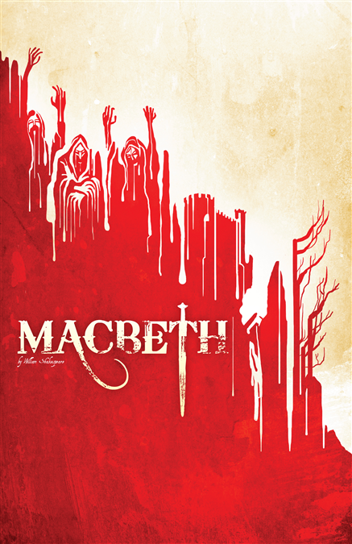
Macbeth
Background & History

Slide 2
Motivation for writing
Shakespeare wrote the play for James I, England’s new king and Scotland’s previous king.
To please King James I, Shakespeare set the play in Scotland and included many of the King’s ancestors.
He also included witches-which King James I had written about.
Macbeth is Shakespeare’s shortest play. Apparently King James I fell asleep during performances, so Shakespeare was appealing to his short attention span ☺

Slide 3
A tribute to King James I
Shakespeare wrote Macbeth in 1606, during King James’ reign.
King James was a devout advocate of the “Divine Right of Kings”:
the doctrine that kings derive their authority from God, not from their subjects, from which it follows that rebellion is the worst of political crimes.
Banquo, a character in the play, is an ancestor of King James and is shown to be a virtuous person.

Slide 4
Historical information
There was no Tudor successor to the throne of England.
Elizabeth I had been instrumental in the death of her cousin, Mary Queen of Scots, who was beheaded.
On her deathbed, Elizabeth wanted to secure her way into Heaven, so she chose Mary’s son James to become the next king of England.
Queen Elizabeth I chose James VI of Scotland to succeed her.
The appointment of James VI unified England and Scotland under one king, so it was a good move politically.
After her death in 1603, James VI of Scotland became James I of England

Slide 5
An Appeal to the Elizabethan Audience
Shakespeare demonstrated the Elizabethan belief that the country is stable if and only if the King is good and virtuous.
Elizabethans believed that evil occurs in darkness, which is prevalent throughout Macbeth.
Elizabethans expected to see a lot of blood and murder, so Shakespeare obliged.
The play was considered a thriller: a threat to an anointed King and the perceived evil behind that threat.

Slide 6
Tragic Hero
Tragic hero must begin the play as a person of importance
Someone looked up to because of position and/or ability
Cannot be an average guy
Never a woman ☹
Tragic hero exhibits extraordinary abilities

Slide 7
Tragic Hero
Tragic hero has a TRAGIC FLAW that leads to his downfall
Tragic flaw is usually associated with HUBRIS- excessive pride
Macbeth’s tragic flaw is driven by his AMBITION
Antagonist- outside forces with whom the hero battles Pushes him toward the tragic ending
Right before his death tragic hero must recognize his flaw – his OOPS moment
Gains the pity of the audience- they then feel fear- for if this can happen to a man so great, what does it mean for the common man.
Tragic hero comes to an unhappy and miserable end and meets death with dignity and courage
Macbeth somewhat problematic in the end for some readers
Question whether or not his OOPS moment is big enough

Slide 8
Comic Relief in Tragedy
Common in every Shakespeare tragedy.
The following of a serious scene with a lighter humorous scene
Gives audience relief
Juxtaposition heightens the prior tragedy

Slide 9
Drama Terms to Remember/Review

Slide 10
Soliloquy
Speech by a character ALONE on stage
Shares innermost thoughts
Only the audience hears.

Slide 11
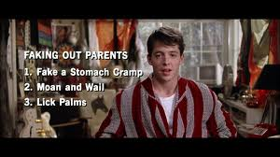
Aside
Remark from a character to the audience
Can also be a remark from one character to another character that other characters on the stage DO NOT hear
Will indicate in the text
aside to- character name
Aside- to audience only

Slide 12
Verse Drama
Dialog consists mostly of poetry with a fixed rhyme or meter
Blank verse- unrhymed iambic pentameter
Shakespeare pulls characters out of verse to indicate something about his or her character

