Slide 1
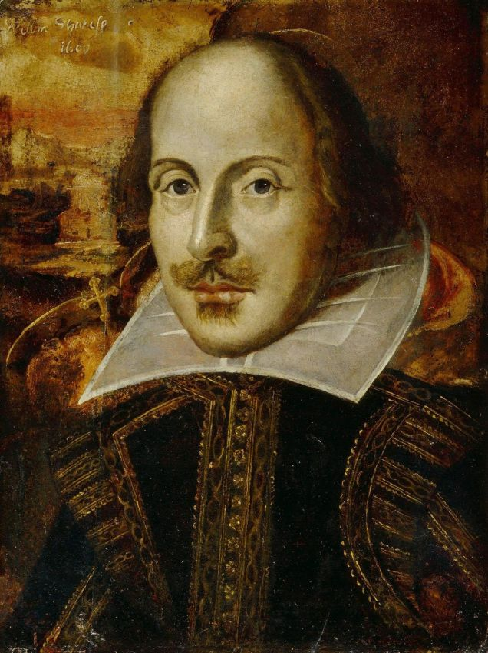
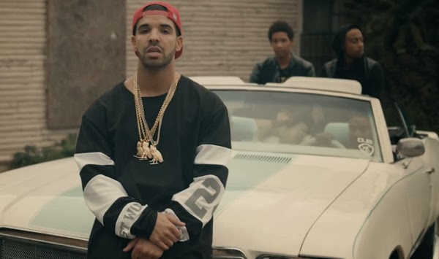
Hip Hop or Shakespeare?

Slide 2
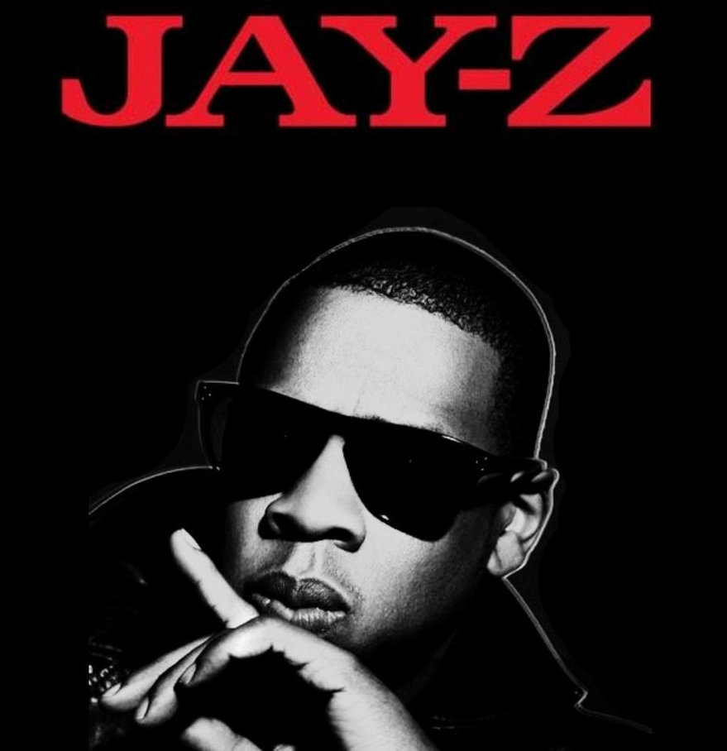
Thumbs up for Shakespeare thumbs down for hip hop
“To destroy the beauty
from which one came”
“You Must Love Me”

Slide 3
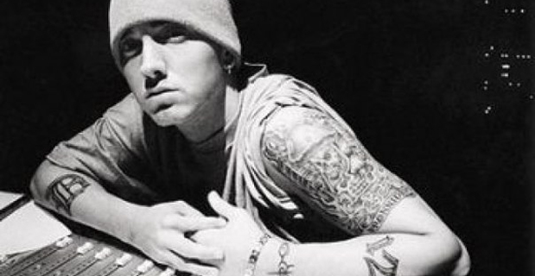
Thumbs up for Shakespeare thumbs down for hip hop
“Maybe it’s hatred I spew, maybe it’s food for the spirit”
“Renegade”

Slide 4
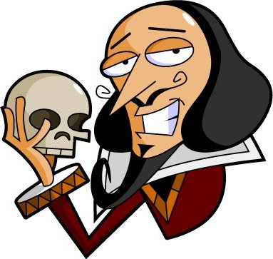
Thumbs up for Shakespeare thumbs down for hip hop
“For in my way it lies. Stars, hide your fires;
Let not light see my black and deep desires.”
Macbeth

Slide 5
Thumbs up for Shakespeare thumbs down for hip hop
“Be a king? Think not. Why be a king when you can be a God?"
“Rap God”

Slide 6
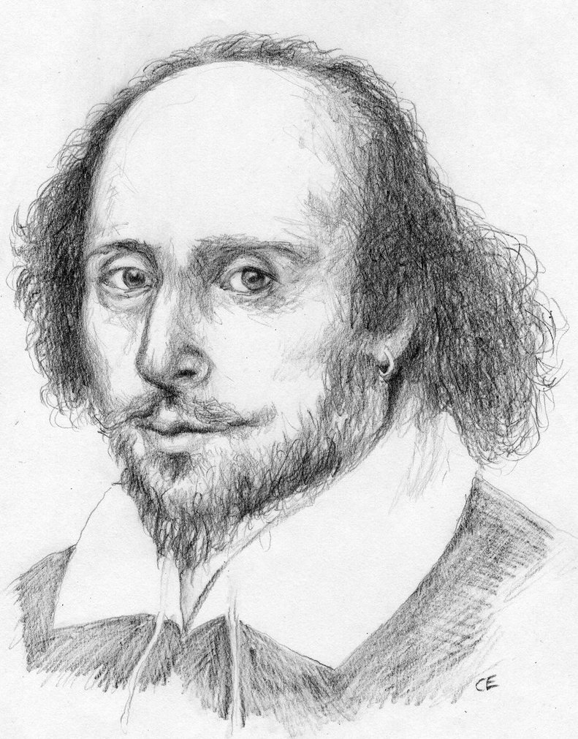
Thumbs up for Shakespeare thumbs down for hip hop
“My Crown is in my heart, not on my head.”
Henry VI

Slide 7
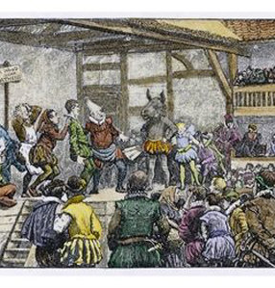
Why did Shakespeare have to be such a deliberate writer?
Audience
Actors
Theater
Director

Slide 8
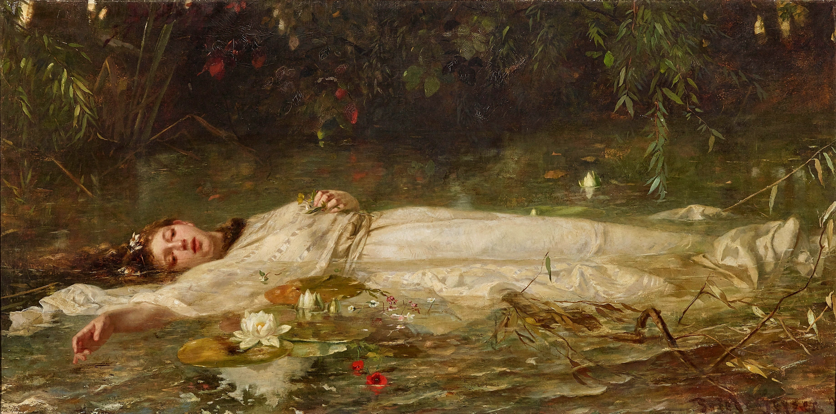
Assonance and Emotions: Ophelia
Oh, what a noble mind is here o'erthrown!—
The courtier’s, soldier’s, scholar’s, eye, tongue, sword,
Th' expectancy and rose of the fair state,
The glass of fashion and the mould of form,
Th' observed of all observers, quite, quite down!
And I, of ladies most deject and wretched,
That sucked the honey of his music vows,
Now see that noble and most sovereign reason
Like sweet bells jangled, out of tune and harsh;
That unmatched form and feature of blown youth
Blasted with ecstasy. Oh, woe is me,
T' have seen what I have seen, see what I see!

Slide 9
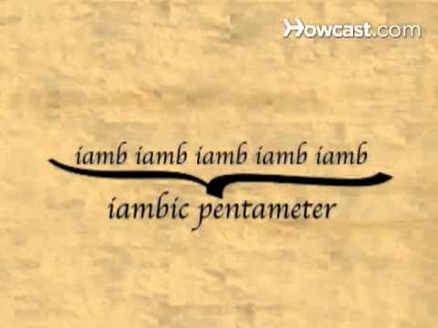
Meter: Iambic Pentameter
Say these words:
Window
Music
Winter
Temptation
Computer
Begin
But, soft! what light through yonder window breaks?

Slide 10
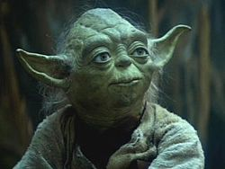
Syntax: Inversions
Yoda:
Powerful you have become, the dark side I sense in you.
Shakespeare:
So long as men can breathe, or eyes can see, So long lives this, and this gives life to thee.

Slide 11
Thumbs up for Shakespeare thumbs down for hip hop
“For in my way it lies. Stars, hide your fires;
Let not light see my black and deep desires.”
Responsible for inventing over 1700 words in the English language.

Slide 12
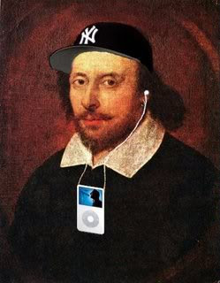
Yes Please! | No Thank You!
You may adjust the form/tense of the word and names to suit Shakespeare. | Do not change the meaning of the lyrics.
Your lines must be in iambic pentameter. | Do not lose the tone and mood of the lyrics.
You must have a minimum of 1 inverted line-refer back to our unit on voice and purpose for syntax. | Do not add explicit language or gestures.
You may change the order and number of lines | Do not look up the rest of the lyrics of the song-you are to create from the 7 lines you were given.
You must read/rap in iambic pentameter. Feel free to designate a heart-beat drummer. | Do not use your phone for evil purposes-stay on task.
You must add assonance to capture speaker’s emotion. | Do not elevate the decibel of your voices as you may have creativity eavesdroppers in the mix.
If you feel like being a little extra, deliver your lines as your hip hop star would.
When I say “Go” send one of the members in bold to get your lines. You have 10 minutes.
Hip Hoppin Will

